Slide 1
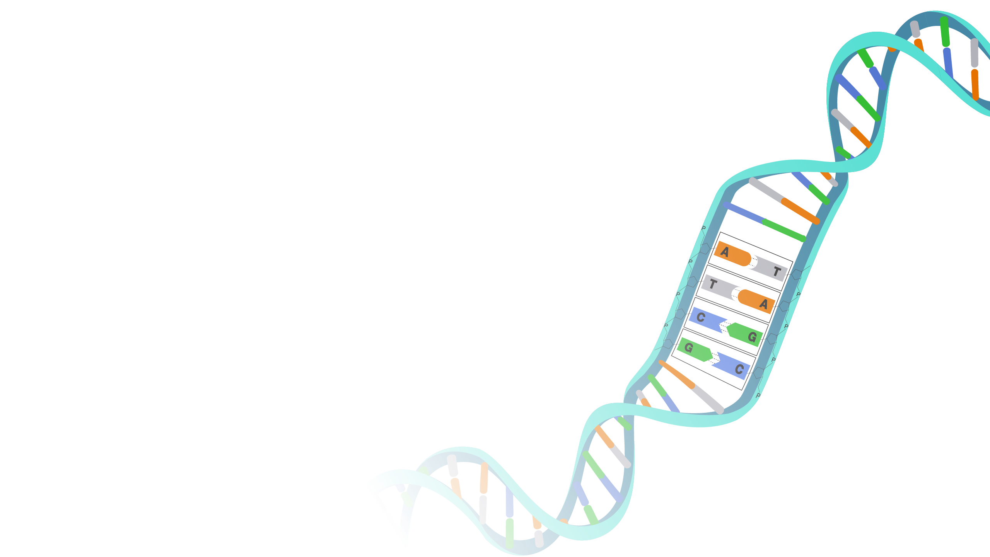
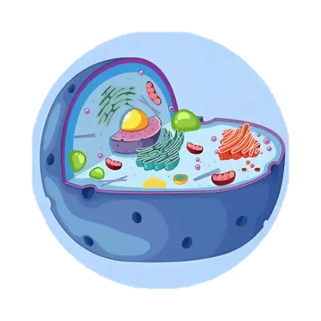
An Introduction to
Single-Cell
RNA Sequencing Data
Gene Regulation

Slide 2
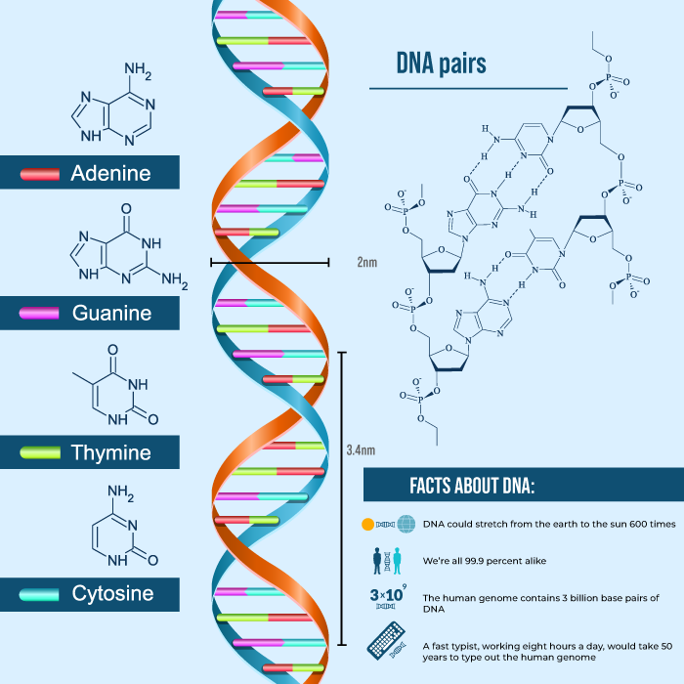
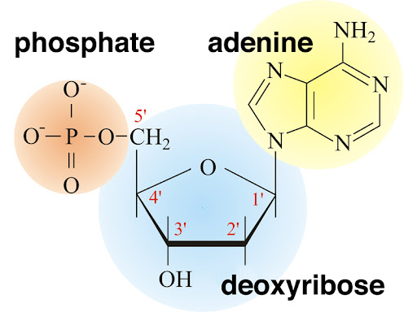
DNA
DNA is made up of small repeating units called nucleotides.
Each nucleotide consists of three components:
Phosphate Group (PO₄³⁻)
Deoxyribose Sugar (C₅H₁₀O₄)
Nitrogenous Base
Adenine (A) → C₅H₅N₅
Thymine (T) → C₅H₆N₂O₂
Cytosine (C) → C₄H₅N₃O
Guanine (G) → C₅H₅N₅O

Slide 3
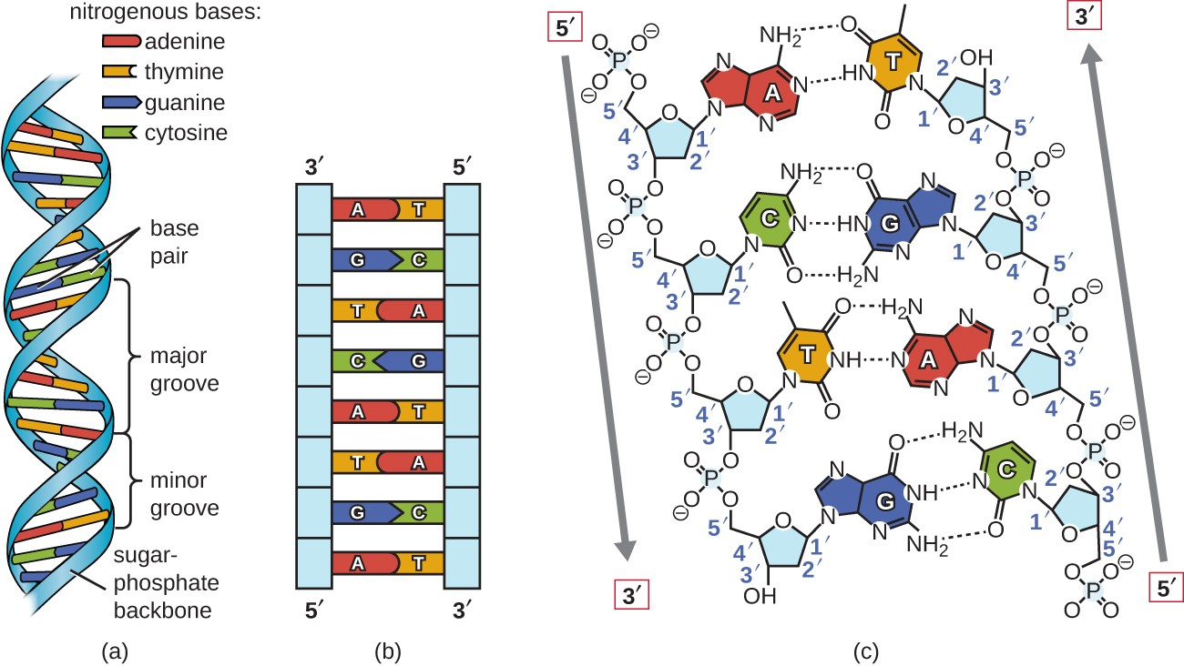
DNA
The two strands of DNA are held together by hydrogen bonds between nitrogenous bases.
Adenine (A) pairs with Thymine (T) (A–T) with 2 hydrogen bonds
Cytosine (C) pairs with Guanine (G) (C–G) with 3 hydrogen bonds
The two DNA strands are oriented in opposite directions (one 5' → 3', the other 3' → 5’).

Slide 4
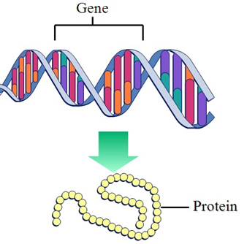
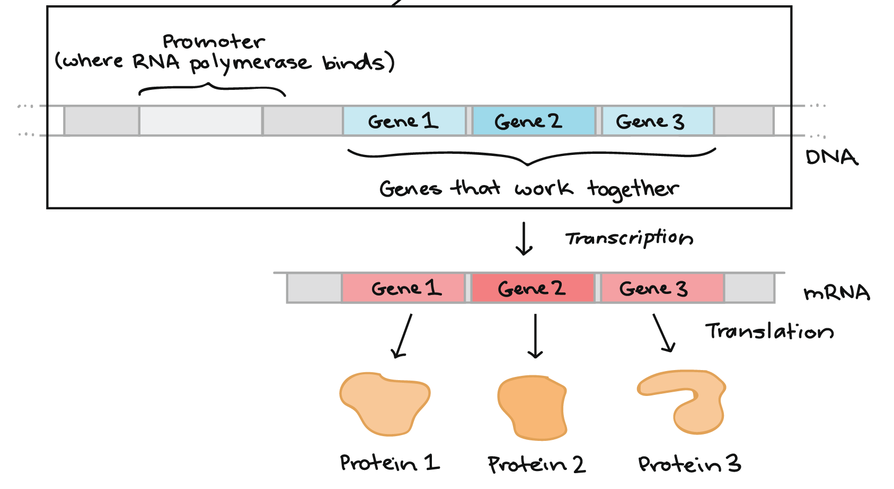
Gene
a sequence of nucleotides in DNA that encodes instructions for building a specific protein.
Promoter region
Coding region
Terminator region
Two main steps:
Transcription: DNA to mRNA
Translation: mRNA to Protein

Slide 5
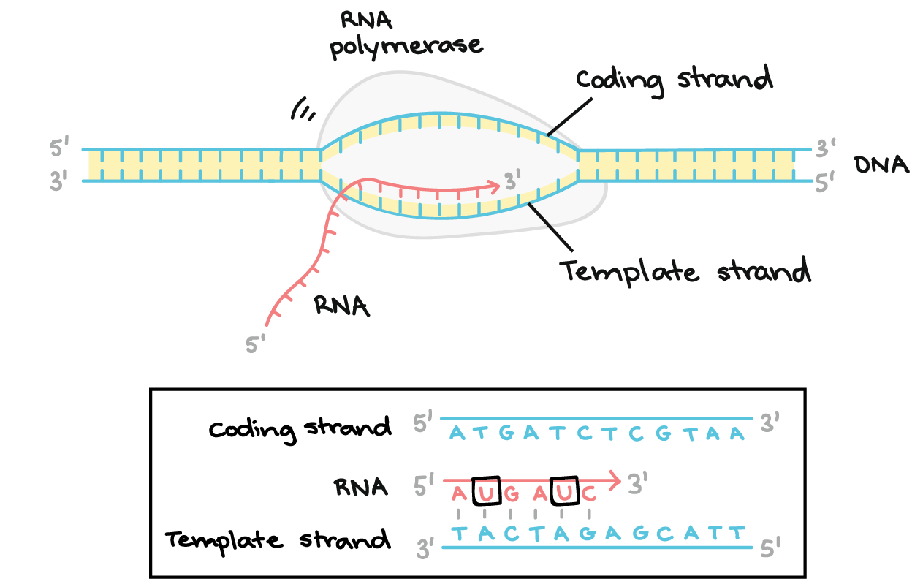
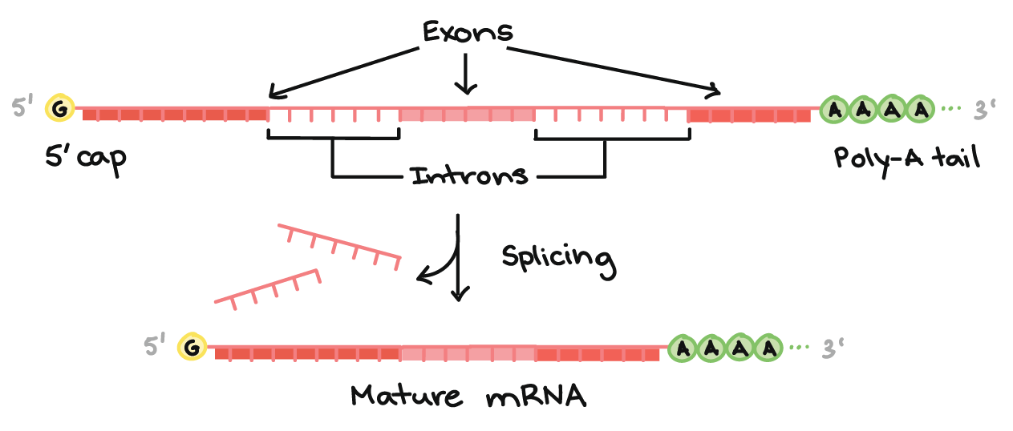
Transcription
Steps:
Initiation:
Binding and Unwinding
Elongation:
A (Adenine) → U (Uracil) (RNA has uracil instead of thymine)
T (Thymine) → A (Adenine)
C (Cytosine) → G (Guanine)
G (Guanine) → C (Cytosine)
Termination
Post-Transcriptional Modifications (in Eukaryotes):
5' Cap Addition
Poly-A Tail Addition
Splicing
Removing introns and joining exons

Slide 6
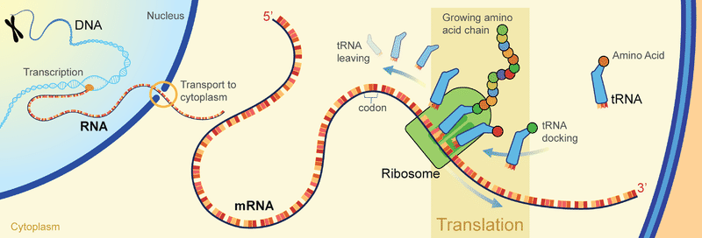
Translation
Initiation:
Attaching ribosome
Start Codon: AUG
Elongation:
tRNA molecules bring amino acids to the ribosome
Each tRNA has an anticodon that matches a specific codon on mRNA.
The ribosome forms peptide bonds between amino acids, linking them into a growing polypeptide chain.
Termination:
Stop Codon: UAA, UAG, UGA
Post-Translational Modifications

Slide 7
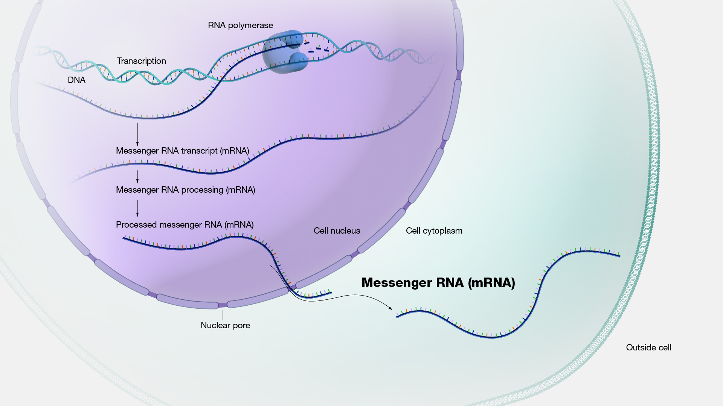

Slide 8
Gene
Regulation
Gene regulation is the process by which cells control the expression of genes, determining when, where, and to what extent specific genes are turned on (activated) or off (repressed).
Gene regulation primarily involves chemical modifications to DNA rather than physically removing or attaching DNA segments.

Slide 9
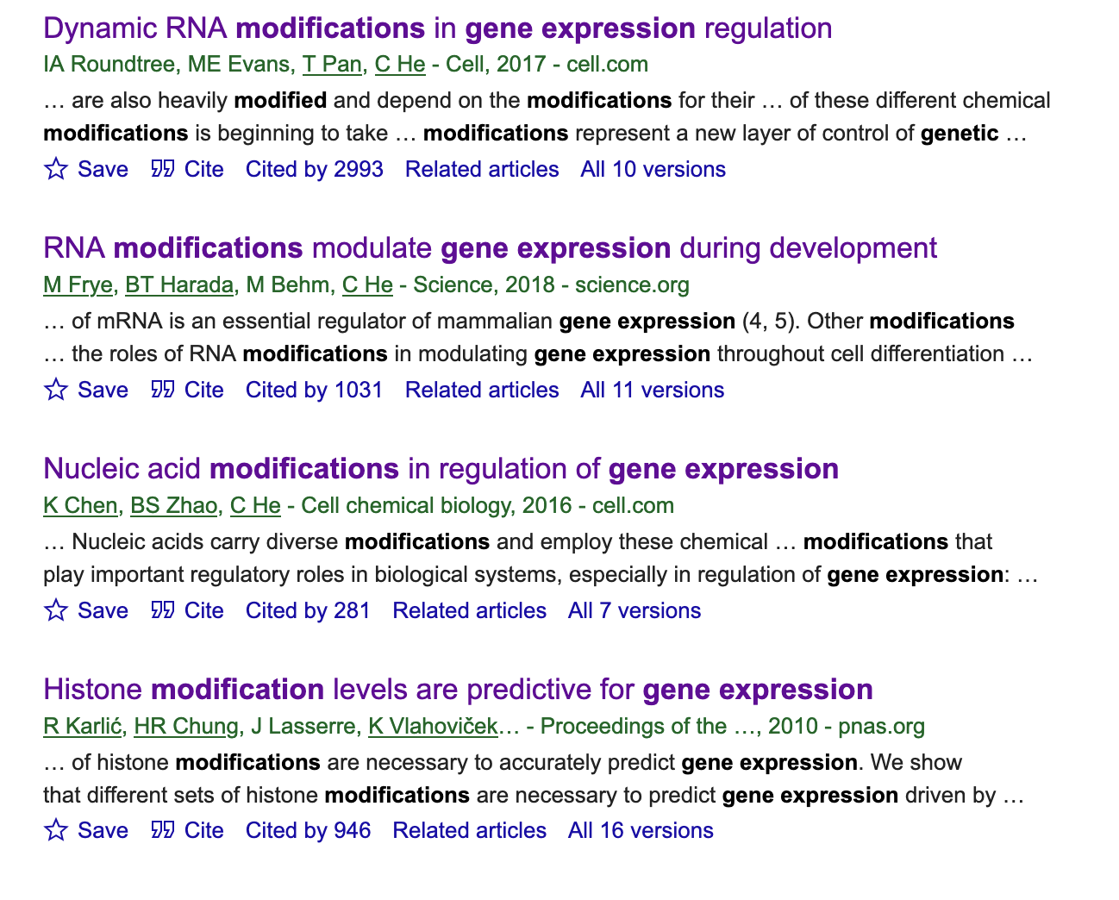
Gene
Modification
Gene modification?
adding, removing, or modifying
specific genes or sequences of DNA.
Removing DNA Sequences : CRISPR-Cas9
Attaching DNA Sequences : PCR

Slide 10
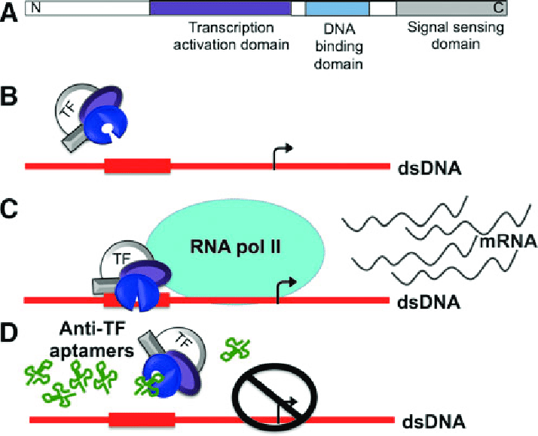
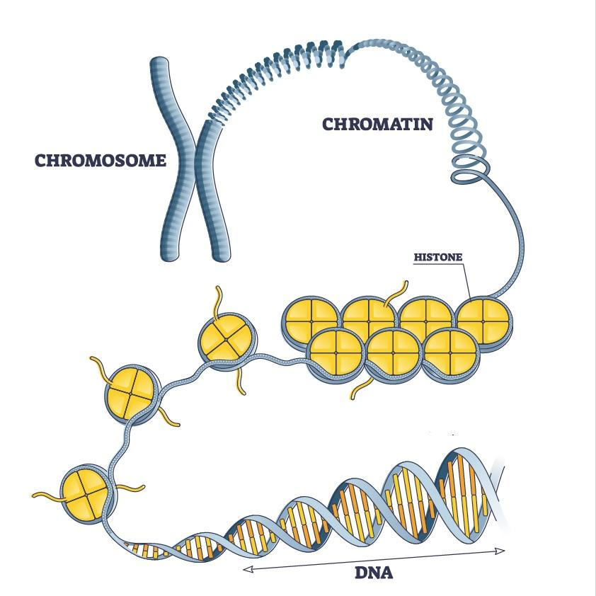
Gene
Modification
Expression of genes
transcription factors [TFs]
Antagonists
consolidator
transcriptional co-factors
chromatin remodelers

Slide 11

?
How can we determine the expression of genes in a cell?
The answer is:
Single-cell RNA Sequencing Data

Slide 12
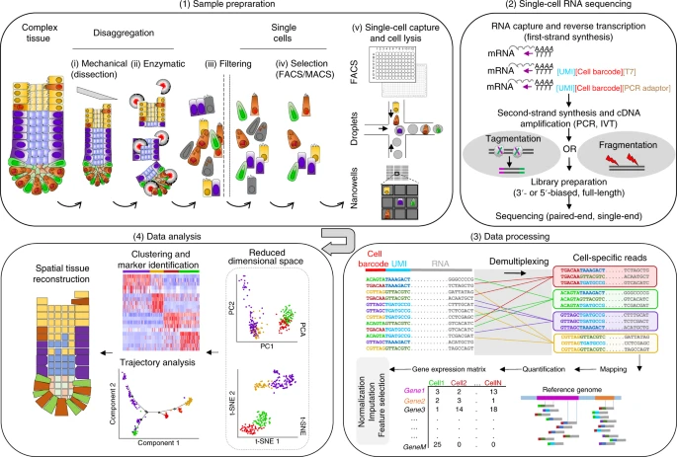
sc-RNA seq

Slide 13
Sample preparation
Steps:
Tissue dissection and cell dissociating to obtain a suspension of cells.
Optionally cells may be selected (e.g. based on membrane markers, fluorescent transgenes or staining dyes).
Capture single cells into individual reaction containers (e.g. wells or oil droplets).
Extracting the RNA from each cell.

Slide 14
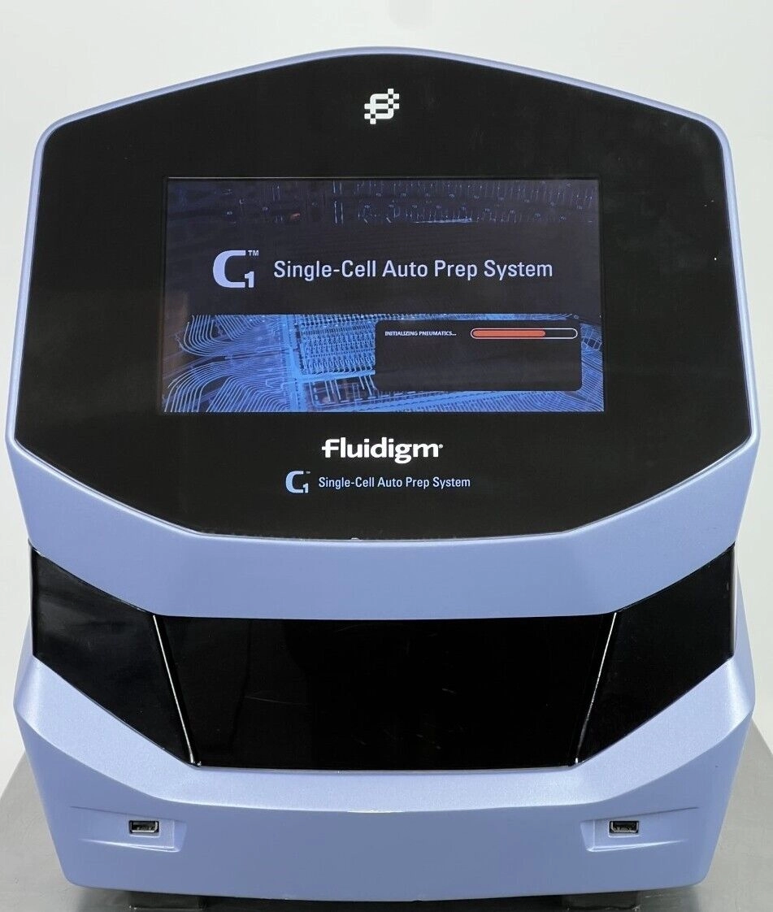
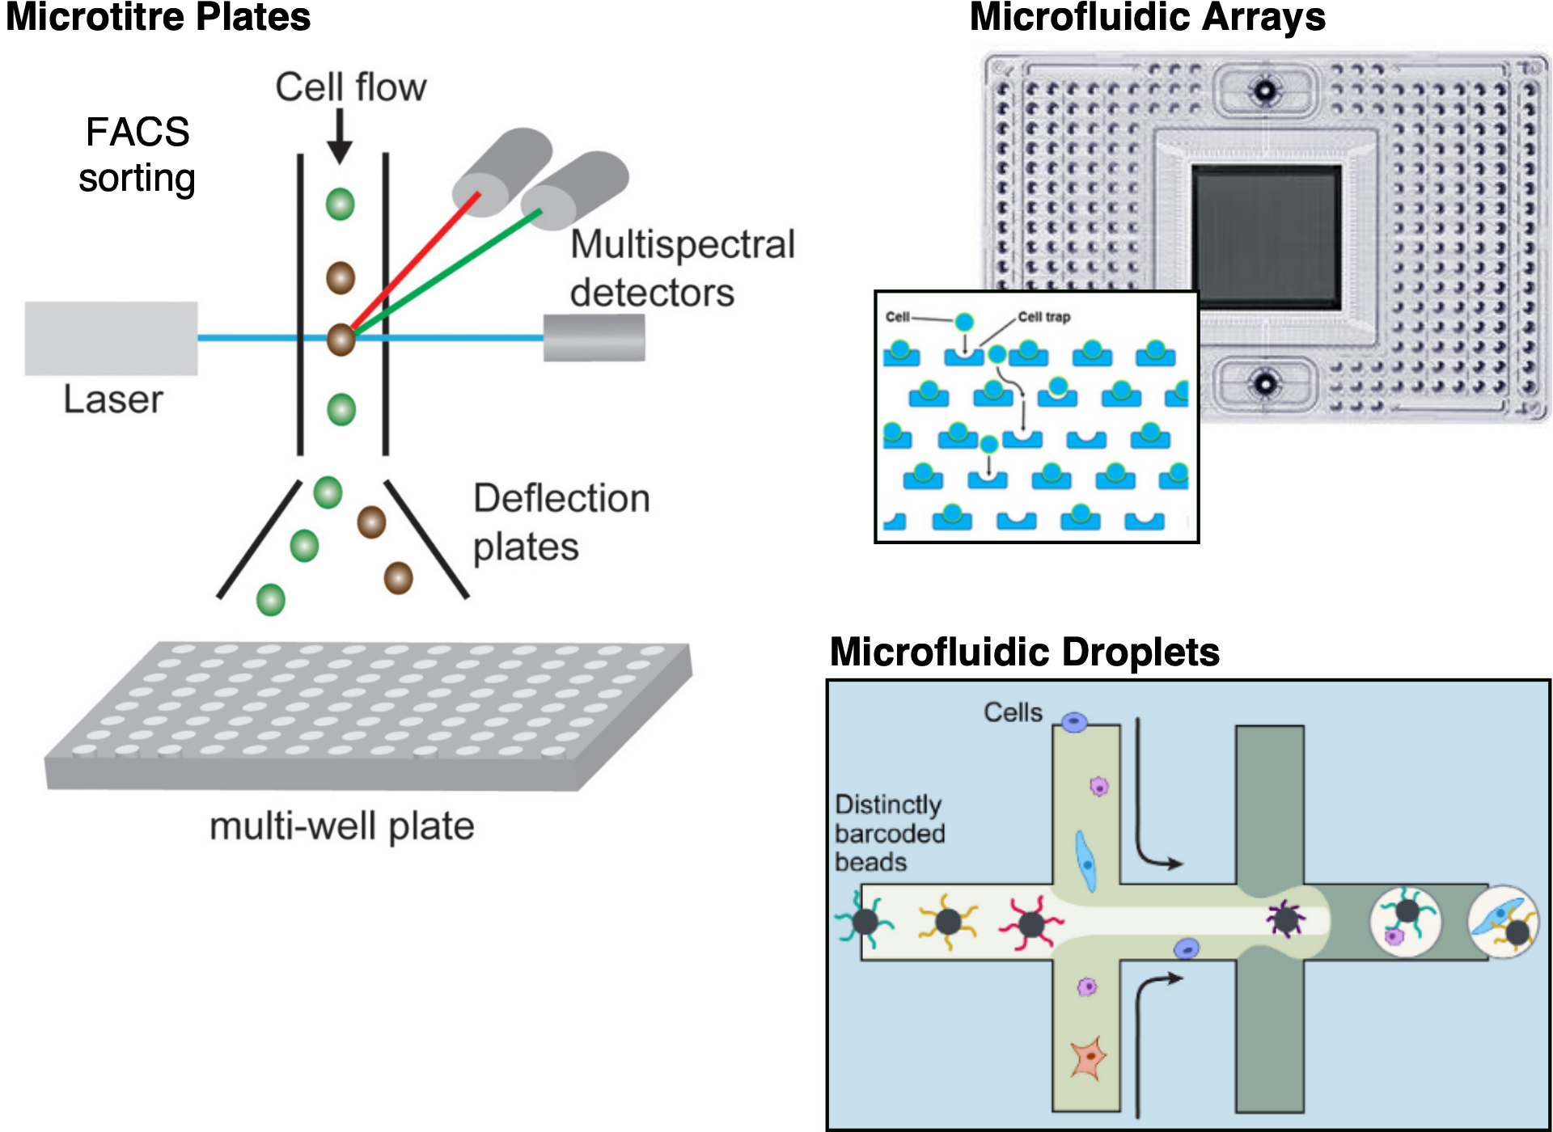
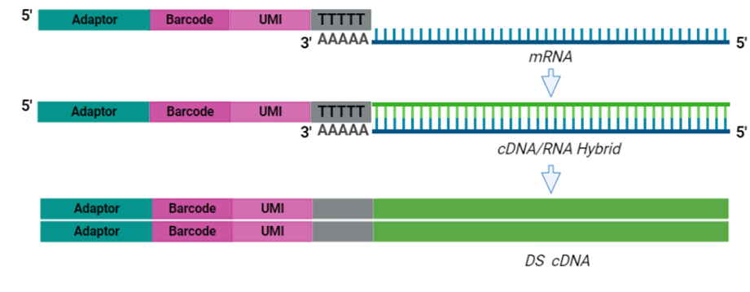
Cell
Capture
Microtitre plate based,
Microfluidic array based
Microfluidic droplet based

Slide 15
Sequencing
full-length
Captures the entire transcript,
from the 5' end to the 3' end.
more informative but expensive and lower throughput.
tag-based
Only captures either the 5' end or the 3' end
Cheaper and more scalable
Loses information

Slide 16
Raw data
Raw data from sequencing
FASTQ format:
The first line begins with '@' followed by a sequence identifier.
The second line contains the actual nucleotide sequence.
The third line starts with a '+' sign and optionally contains the same identifier.
The fourth line encodes the quality scores corresponding to the nucleotide sequence.
@SEQ_ID_1
GATCGGAAGAGCACACGTCTGAACTCCAGTCAC
+
IIIIIIIIIIIIIIIIIIIIIIIIIIIIIIIIII
@SEQ_ID_2
AGCTAGCTAGCTAGCTAGCTAGCTAGCTAGCTA
+
IIIIIIIIIIIIIIIIIIIIIIIIIIIIIIIIII
@SEQ_ID_3
TTTAAAGGGCCCTTTAAAGGGCCCTTTAAAGGG
+
IIIIIIIIIIIIIIIIIIIIIIIIIIIIIIIIII
@SEQ_ID_4
CGTACGTACGTAGCTAGCGTGACGTAGCTAGCT
+
IIIIIIIIIIIIIIIIIIIIIIIIIIIIIIIIII

Slide 17
Raw data
processing
@SEQ_ID_1
GATCGGAAGAGCACACGTCTGAACTCCAGTCAC
+
IIIIIIIIIIIIIIIIIIIIIIIIIIIIIIIIII
read_1 99 chr1 100 60 4M 5S = 200 300 ACGTACGT IIIIIIII

Slide 18
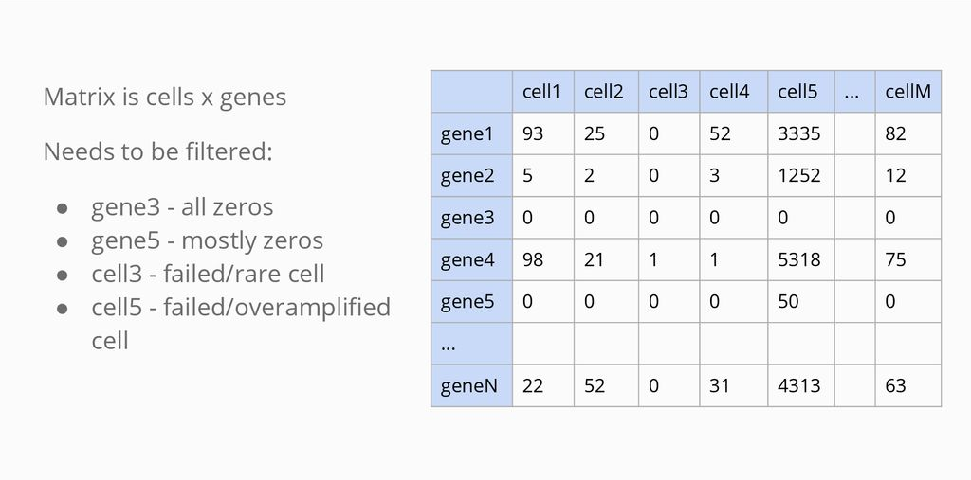
Count Matrix
From Reads to a Count Matrix

Slide 19
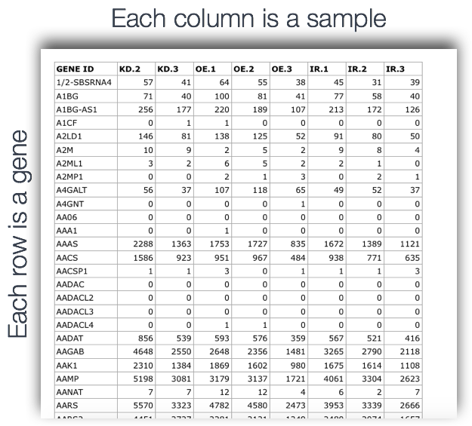
Count Matrix
From Reads to a Count Matrix

Slide 20
Quality
Control
Three main key factors : QC covariates
Count depth
Low count depth ➡️ damaged or broken cells
Very high count depth ➡️ doublets
Threshold ➡️ 500, 20,000
The number of genes per barcode
Low ➡️ dead cells or empty droplets
Very high ➡️ doublets
The fraction of counts from mitochondrial genes per barcode
Very high ➡️ dying or stressed cells, broken cells
A normal mitochondrial fraction for a healthy cell is typically less than 5–10%

Slide 21
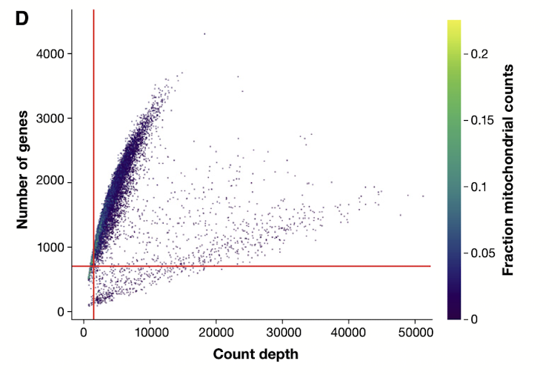
Quality
Control

Slide 22
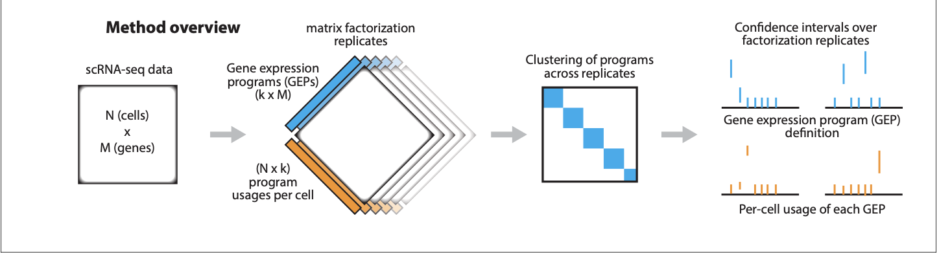
Papers
Identifying gene expression programs of cell-type identity and cellular activity with single-cell RNA-Seq
Dylan Kotliar1,2,3†*, Adrian Veres1,3,4†, M Aurel Nagy3,5, Shervin Tabrizi2, Eran Hodis3,6, Douglas A Melton4,7, Pardis C Sabeti1,2,7
cNMF (consensus non-negative matrix factorization)
Activity Program
Identity program

Slide 23
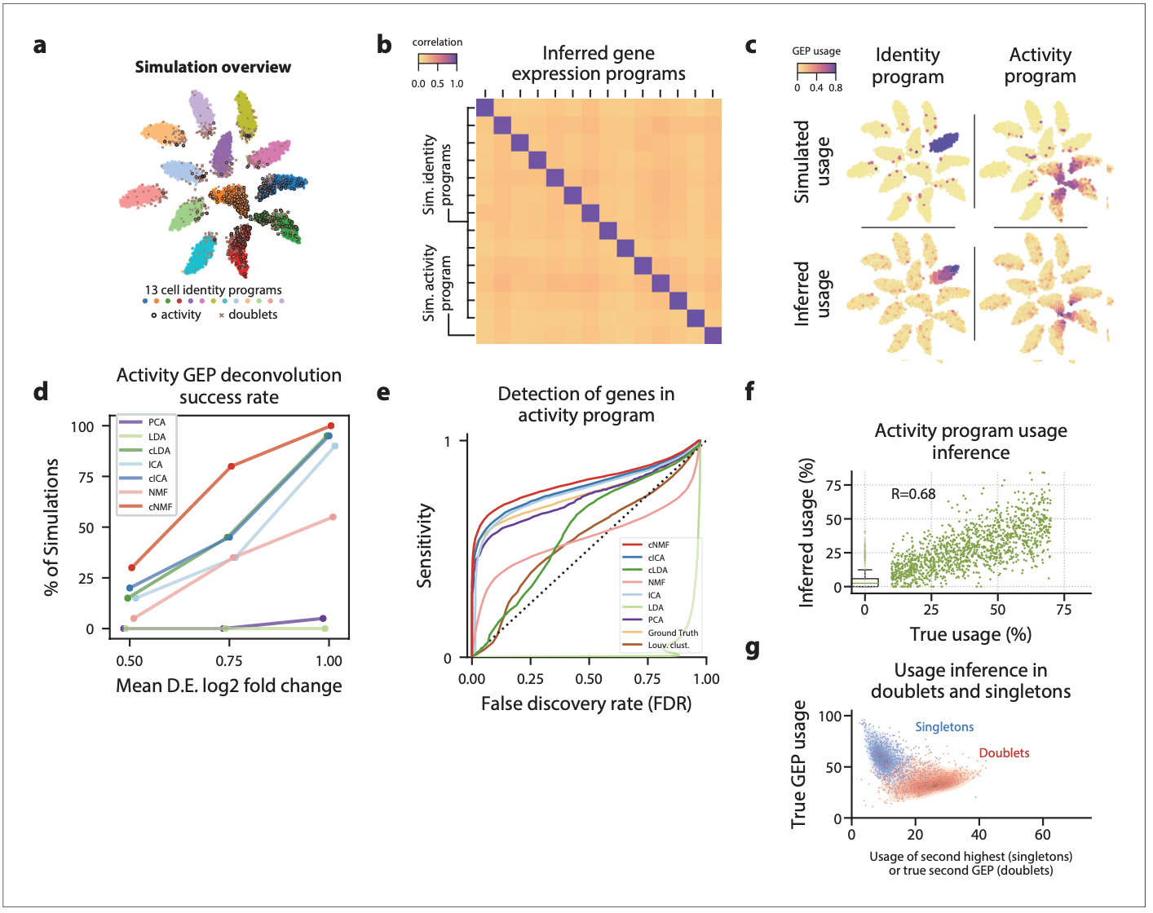

Slide 24
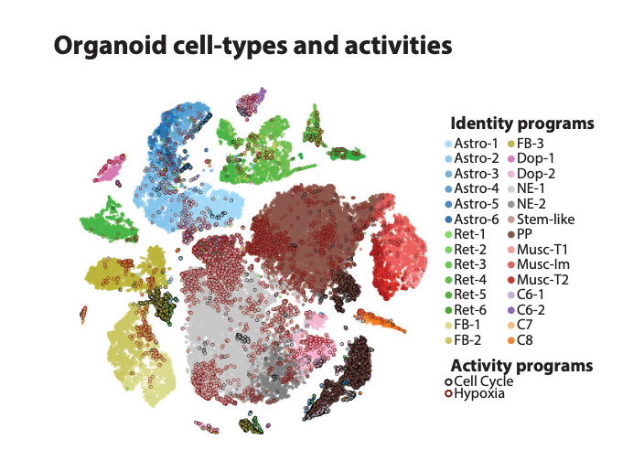

Slide 25
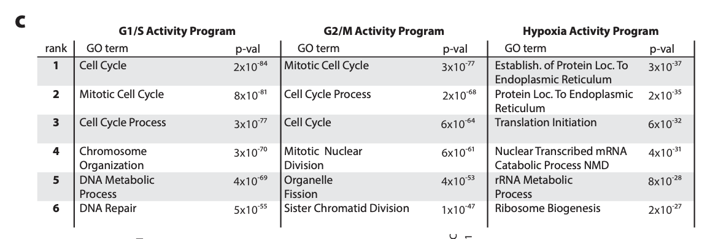

Slide 26
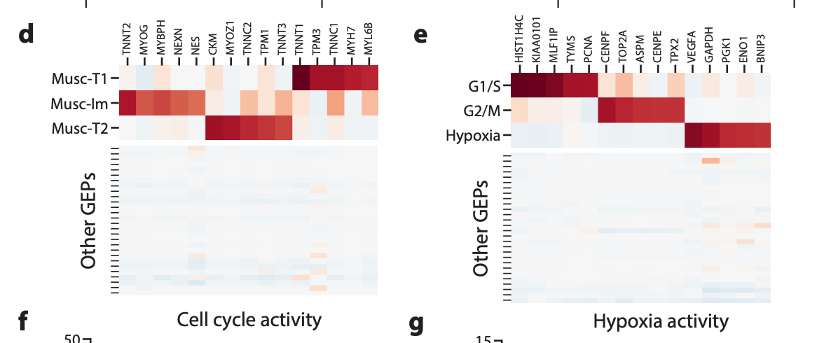

Slide 27
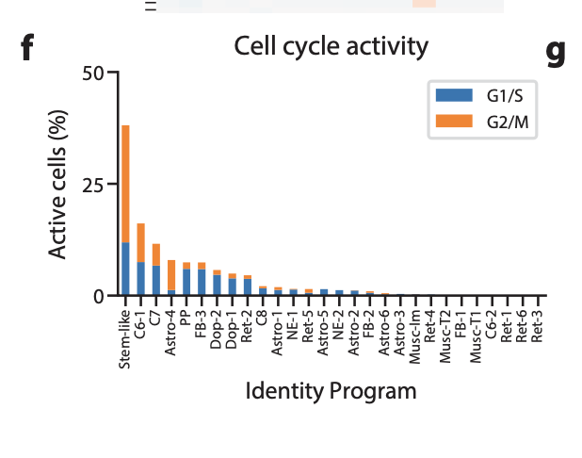

Slide 28
Next session

